Slide 1
Ultima 2.0
Phase V - Final presentation
Giovanna Gorski

Slide 2
Ultima 2.0
Phase I
Scheduler and Semaphore
February 23, 2020
Phase II
Message Passing (IPC)
April 5, 2020
Phase III
Memory Management
April 13, 2020
Phase IV
File System
April 27, 2020
Phase V
Final Presentation
May 5, 2020
Author: Giovanna Gorski
(574) 302 - 1987
ggorski@iu.edu
Instructor: Dr. Hossein Hakimzadeh
hhakimza@iusb.edu
Indiana University of South Bend
Spring 2020

Slide 3
Phase I - Scheduler & Semaphore
The purpose of this phase is to develop a Scheduler mechanism which will be responsible to control running tasks during the execution of the program alongside the development of a Binary Semaphore which prevents certain critical parts of the code to be executed by more than one task at the time, thus, preventing problems such as race conditions. Furthermore, phase I required the implementation of a Thread Table in the form of a linked list to store information over create tasks as well as some Standard Libraries (Queue and Linked List).

Slide 4
How a thread is created
3 important functions as orders follows:
Scheduler::create_task();
Scheduler::worker();
Scheduler::start();

Slide 5
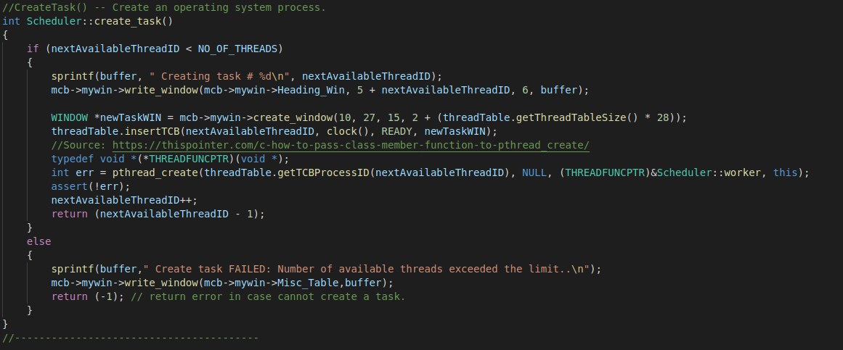
1. Scheduler::create_task();

Slide 6
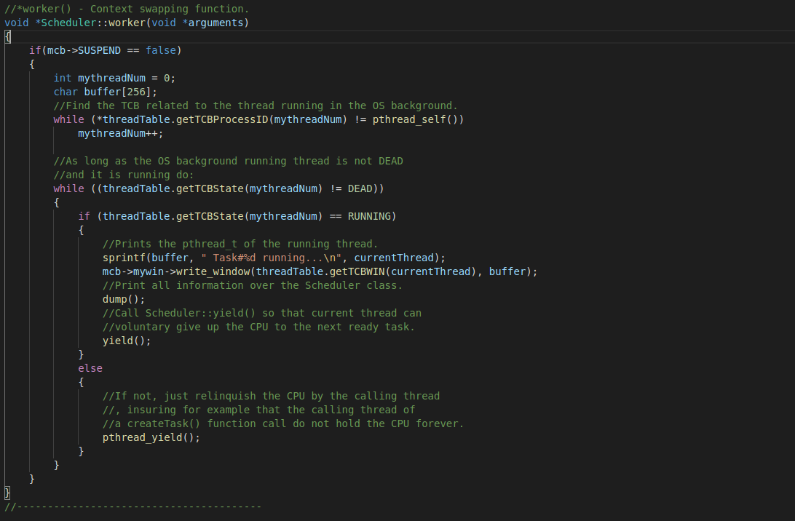
2. Scheduler::worker();

Slide 7
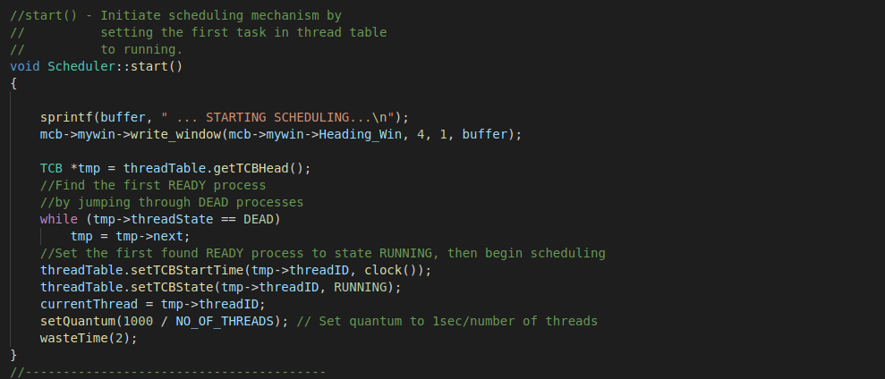
3. Scheduler::start();

Slide 8
Other important functions
Scheduler::yield() - runs the thread by display some information, then goes to sleep so that another task runs.
Scheduler::dump() - display the thread table information.
Scheduler::garbageCollector() - remove threads of state DEAD.
Scheduler::destroyTask(int) - set a specific thread state to DEAD.

Slide 9
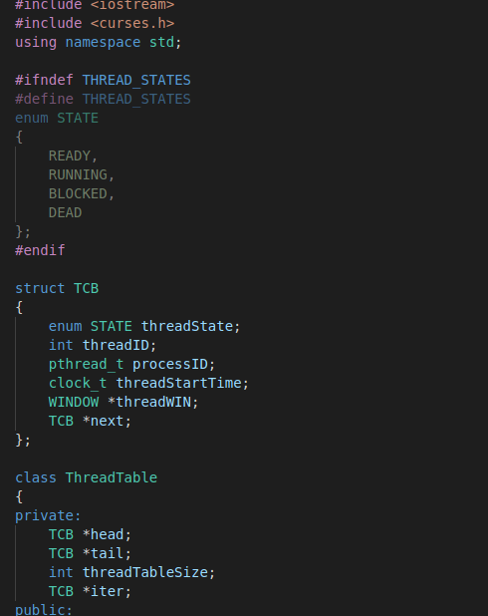
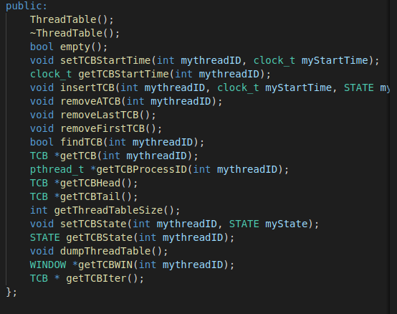
How my thread information is stored
ThreadTable.h - Similar to a Linked List data structure, however, it is a class of its own.

Slide 10
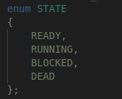
Thread States
READY - Ready to run.
RUNNING - Currently running.
BLOCKED - Waiting on resource.
DEAD - Thread Killed.

Slide 11
Unit Testing
Scheduler:
Creating more than 3 threads.
Killing a thread and calling garbage collector.
Semaphore:
Normal run, one thread owns resource then others try to also obtain and release it.
Deadlock - Two threads engaging in circular wait.

Slide 12
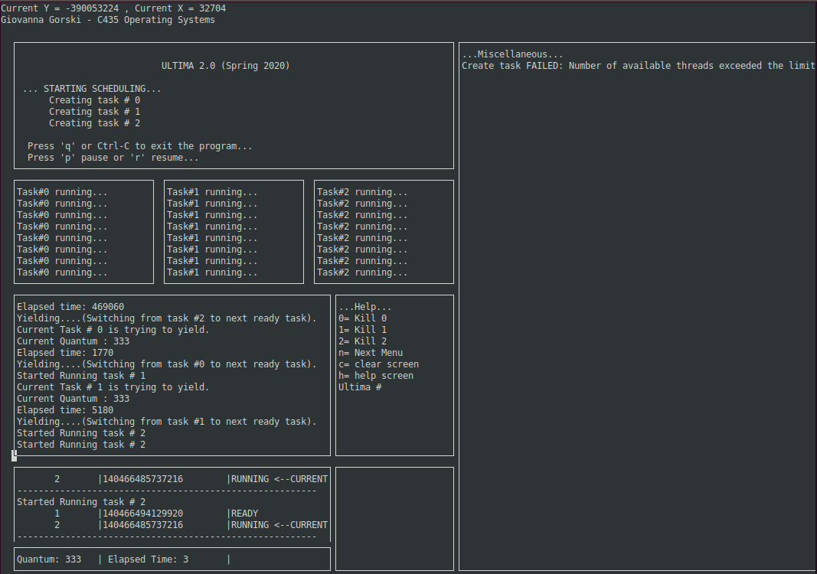
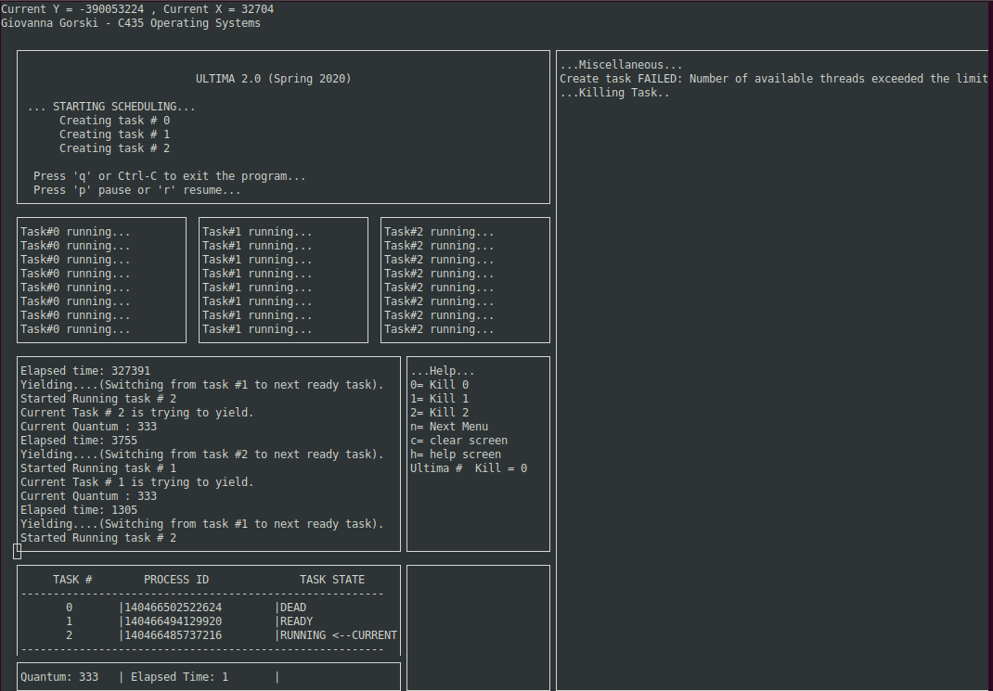
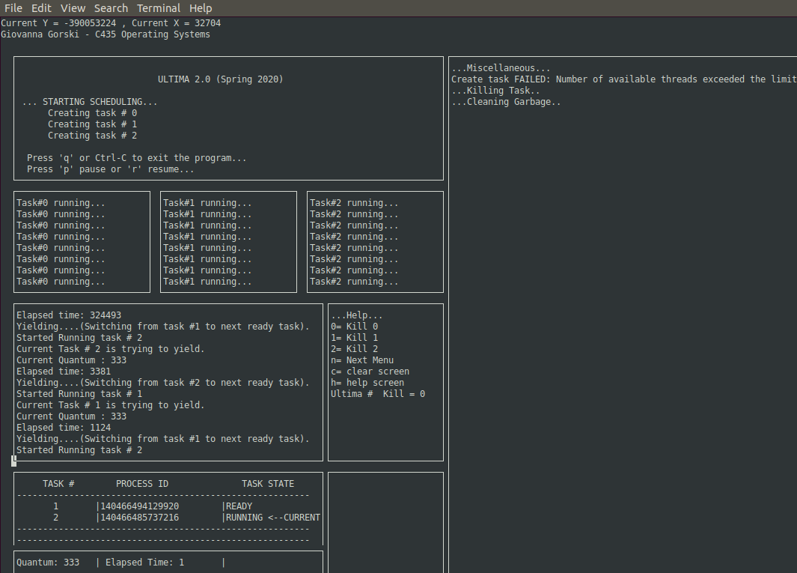
Scheduler
Capability of 3 threads but testing to create 4.
Kill 0 test and garbage collector test.

Slide 13
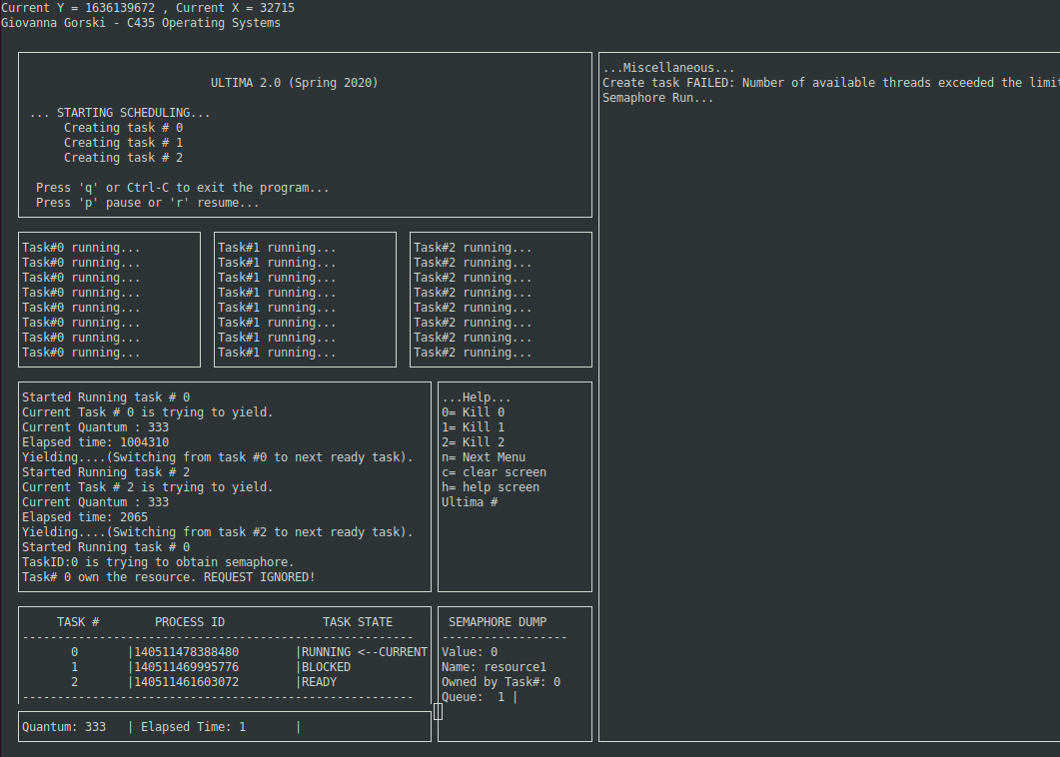
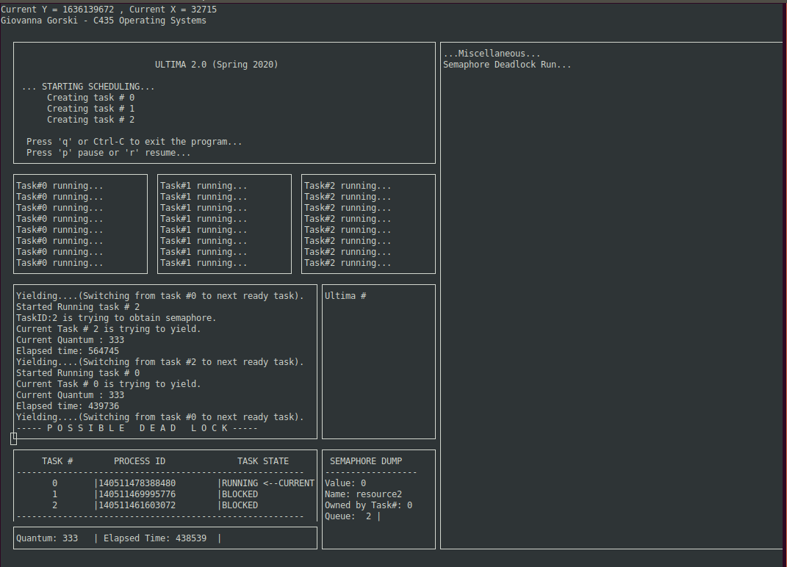
Semaphore
Simple run.
Forcing deadlock

Slide 14
Phase II - Message Passing(IPC) and MCB
The purpose of this phase is to develop a message passing mechanism which will be responsible to send messages through running tasks during the execution of the program alongside the development of a Master Control Block which registers the objects of other fundamental mechanisms such as the Scheduler, Semaphore, and message passing mechanism (IPC). Furthermore, phase II required the implementation of two new classes: the IPC (Inter process communication), and the MCB (Master Control Block).

Slide 15
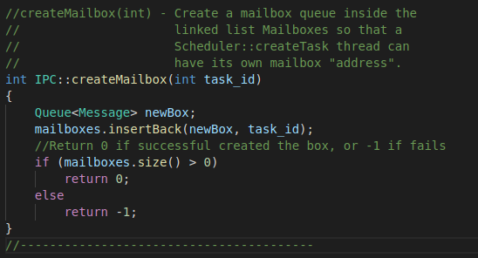
How Message passing is implemented
Each thread has its own mailbox queue to store
its messages then each created queue is inserted
as a node into a linked list of mailboxes containing
all existent thread’s mailboxes in Ultima.
LinkedList<Queue<Message>> mailboxes;

Slide 16
How a message is sent and received
Send - By finding in the Linked List of mailboxes the destination mailbox node then enqueueing the
new message.
Receive - By finding in the Linked List of mailboxes the interested mailbox node then displaying and
dequeuing the top message in the thread’s mailbox (queue node).

Slide 17
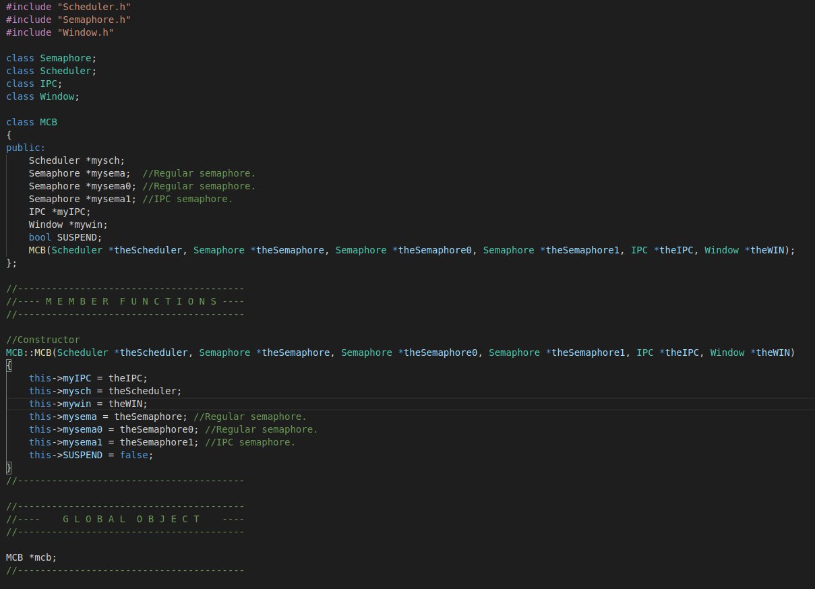
How the Master Control Block is implemented

Slide 18
Unit Testing
IPC:
Send 5 text messages to 5 random threads.
Dump entire ipc.
Display message count to current running thread id.
Current thread running receives a message.
Current thread running deletes all its messages in mailbox.

Slide 19
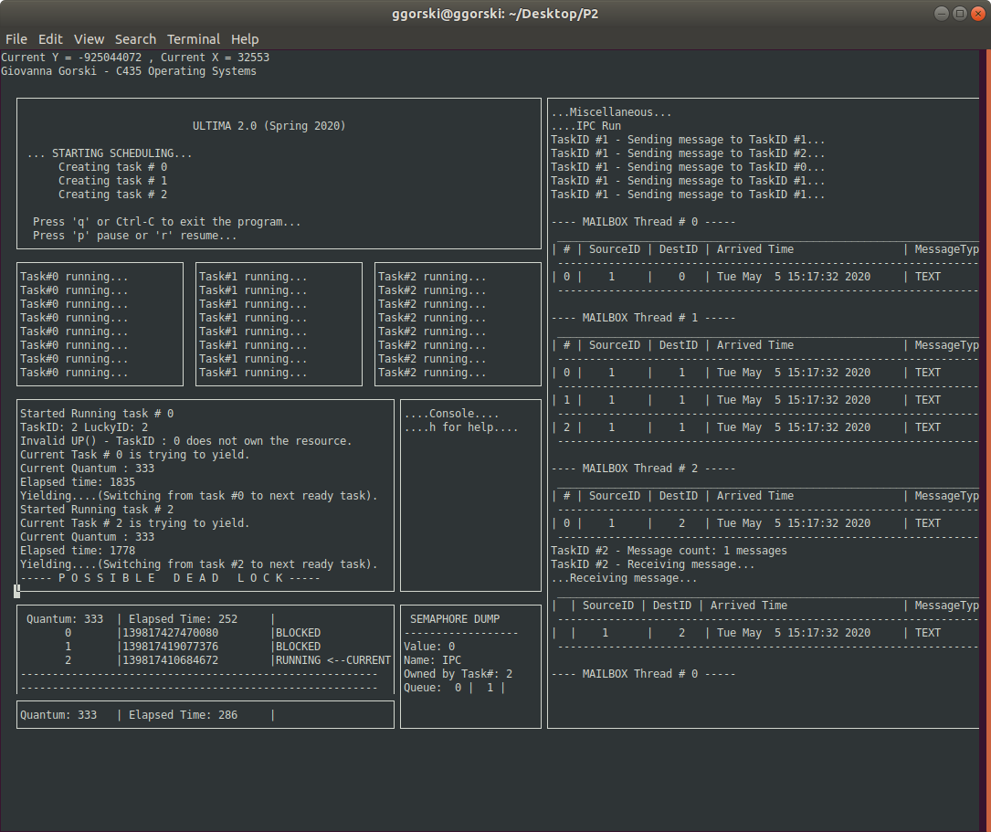
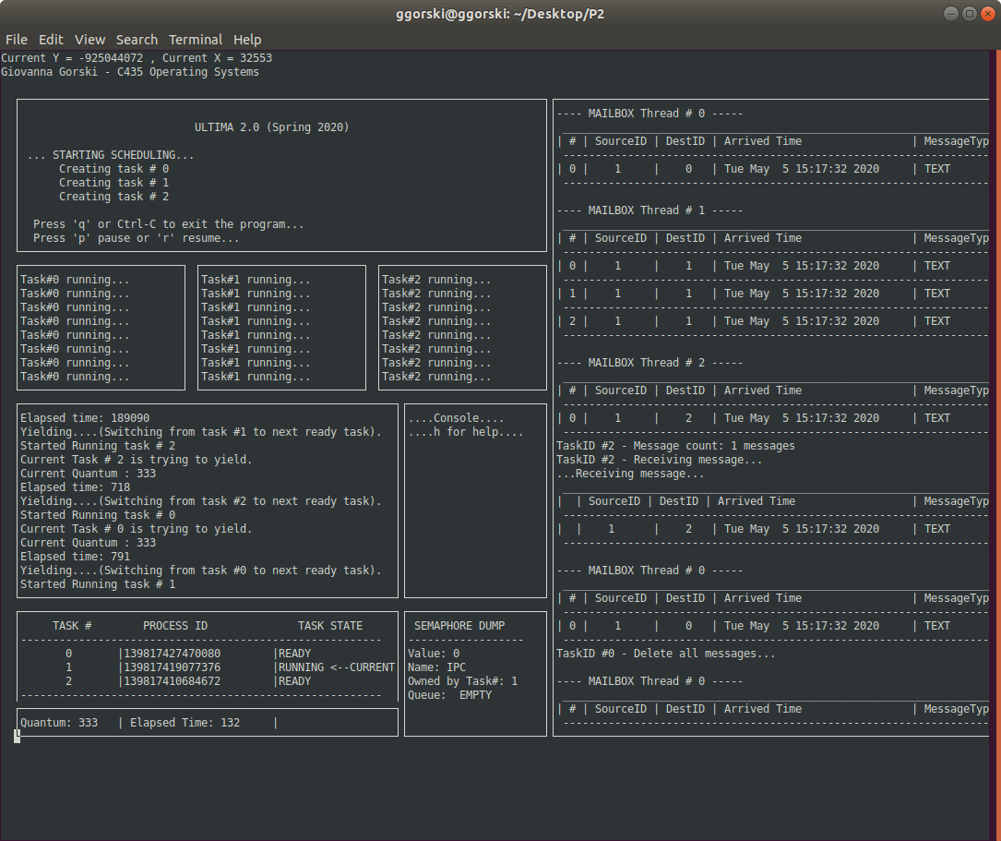

Slide 20
Why the MCB?
The MCB allows mechanisms to access and to use other mechanisms within its class. For example, the IPC class can display messages in the GUI by accessing the Window object from the MCB as well as the IPC also can access a Semaphore by the MCB for critical region protection.

Slide 21
Phase III - Memory Management
The purpose of this phase is to develop a memory management mechanism which allows the tasks that are running to request memory so that one can write or read if the same owns the memory location. Altogether, additional functions for memory management were implemented such as burp, coalesce, and memory free. Furthermore, a new class Window is implemented to provide a small GUI for Ultima to easily debug and navigate.

Slide 22
How memory is allocated
Memory is first allocated as a unique block of size 1024 then its split whenever a new segment is created.
The split happens by creating a new node(segment) in the linked list that manages my array memory, moreover, at each split adjustments in base and limit registers are performed accordingly.

Slide 23
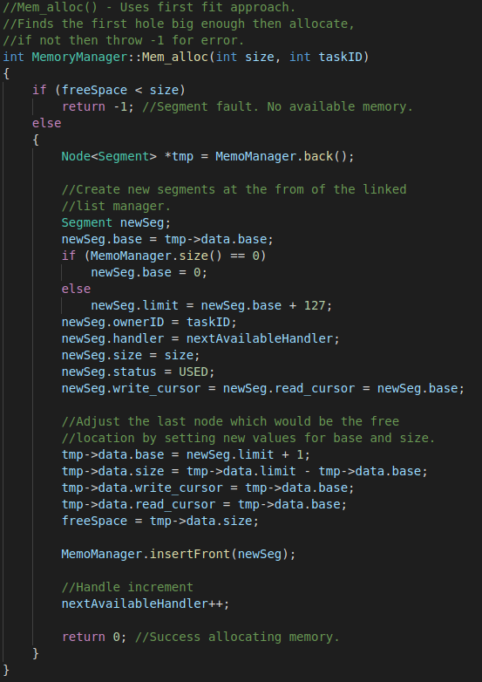
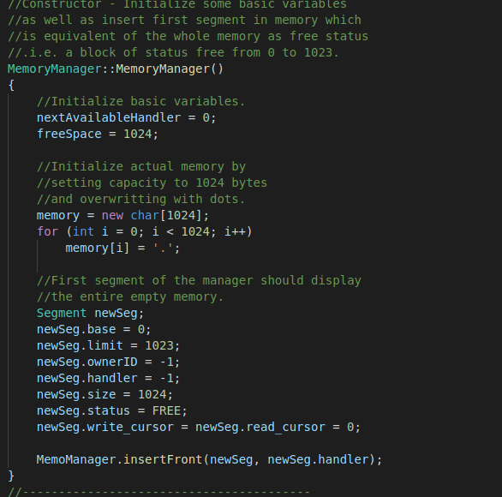

Slide 24
Important functions
MemoryManager Constructor - Allocates its firstmost node as FREE of size 1024.
Mem_alloc(int, int) - Insert a new memory segment in list, adjust free segment.
Mem_free(int, int) - Remove a memory segment in list by first overwriting it with #
then calling coalesce to replace # for . and merge two free segments.
Mem_coalesce() - Merge two adjacents free blocks.

Slide 25
Testing
Memory Manager:
Allocate one block.
Multibyte write.
Char read.
Multibyte read.

Slide 26
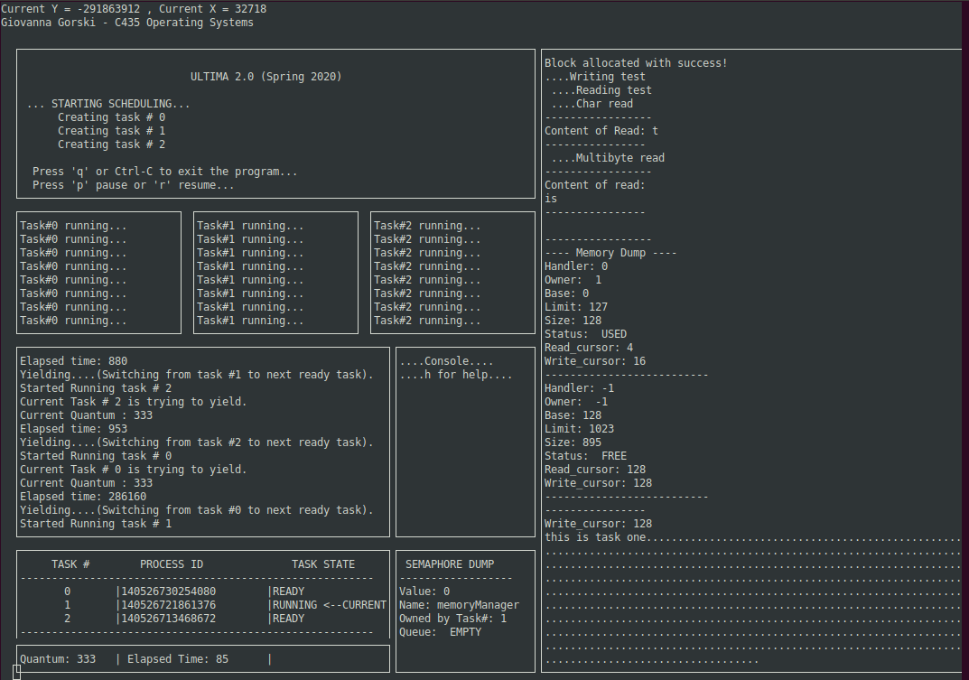

Slide 27
Testing
Memory Manager:
Testing free allocated block.
Combined with coalesce.

Slide 28
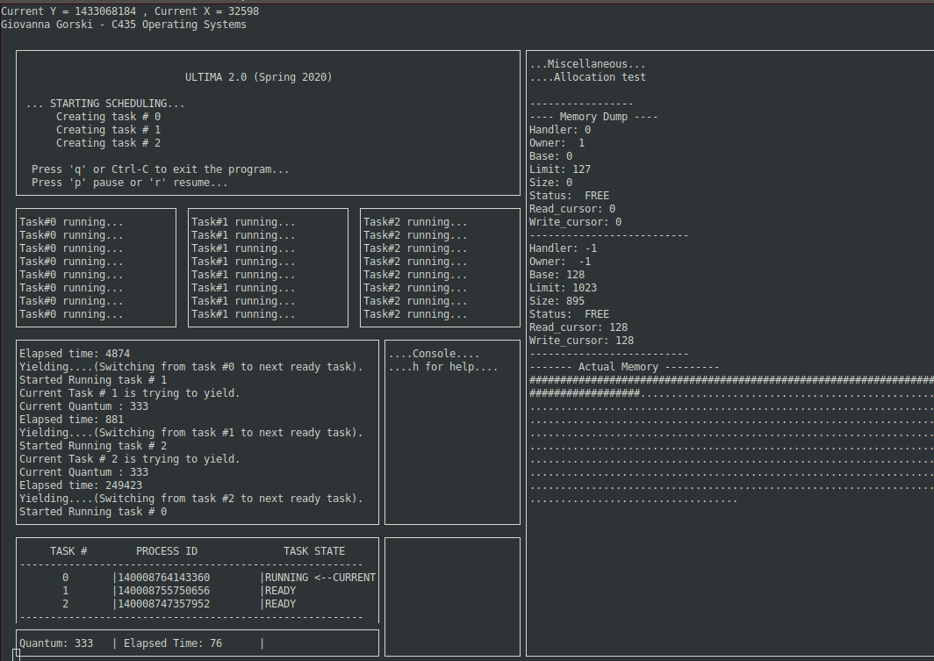
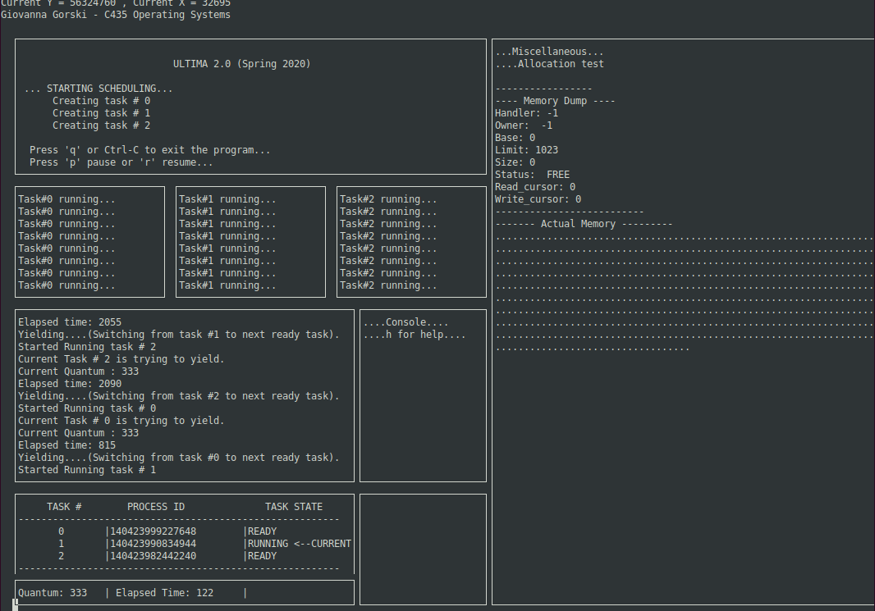
Memory Free

Slide 29
Phase IV - File systems
The purpose of this phase is to develop a file system mechanism which allows the tasks that are running to create files so that one can write or read according to permissions set during creation. Moreover, a file system allows information stored to be persistent which means that it can be preserved as well as it can be loaded back in the next program execution or Ultima execution. Altogether, additional functions for file systems were implemented such as directory dumps, datafile (or disk) dump, read character, and write character.

Slide 30
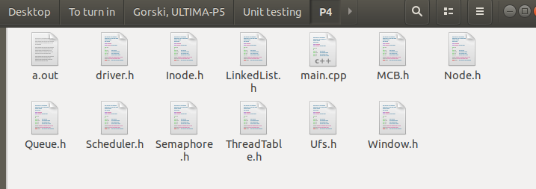
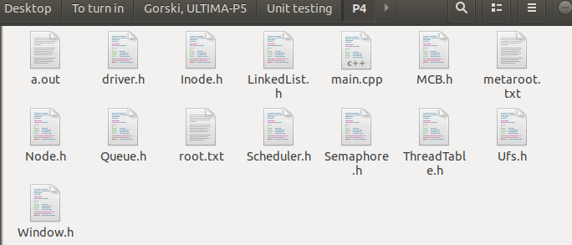
Testing
Ufs constructor, no previous file
After running first time, root and metaroot created

Slide 31
Creating files

Slide 32
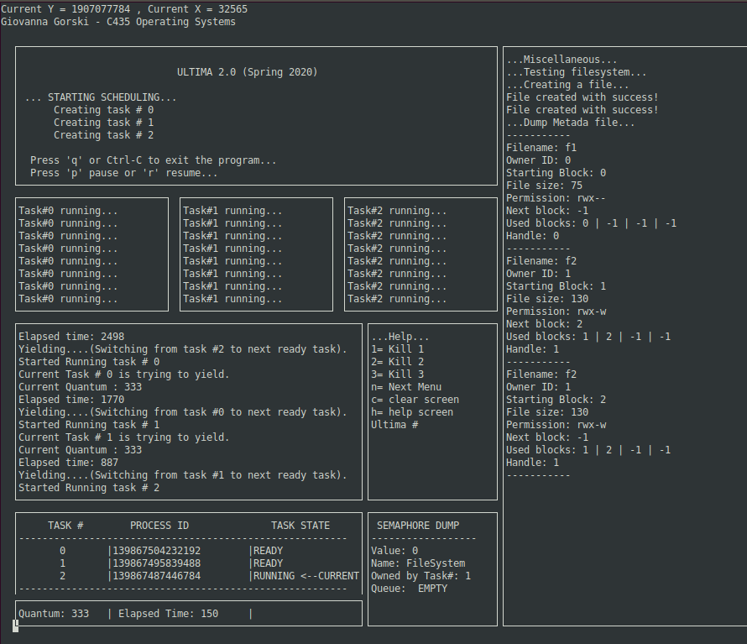

Slide 33
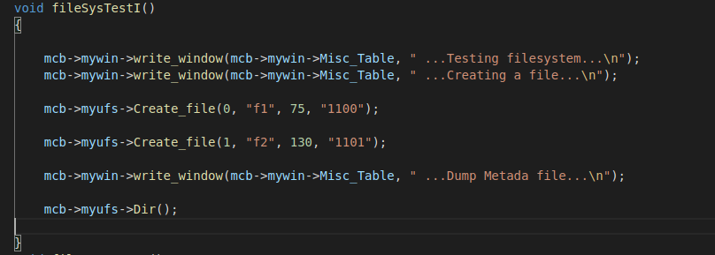
Test function

Slide 34
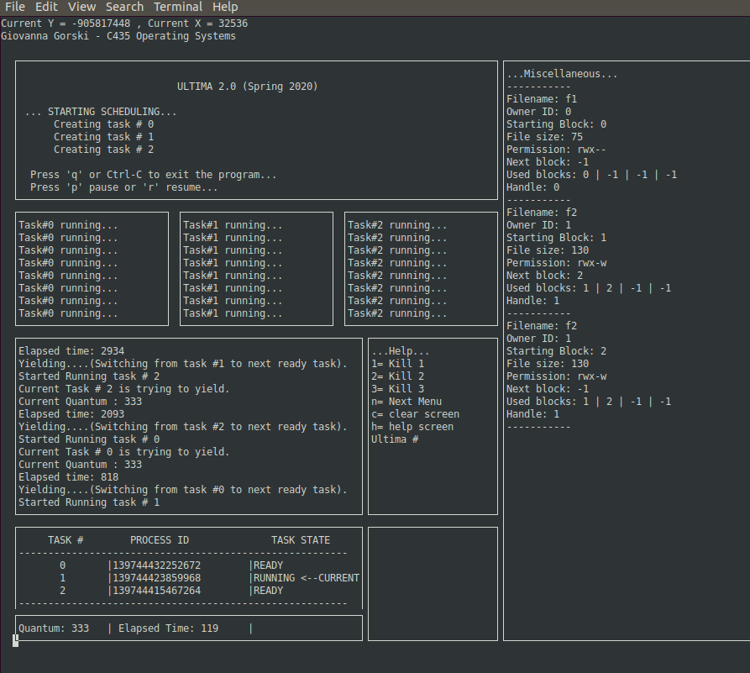
Data persistence

Slide 35
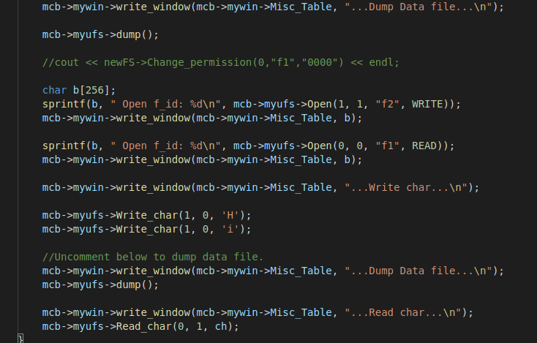
Testing other functions

Slide 36
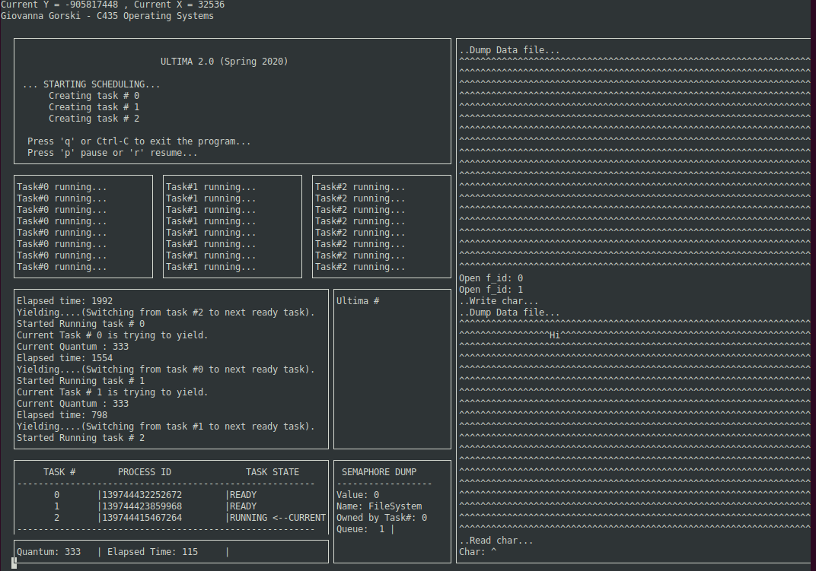

Slide 37
Other implemented classes

Slide 38
Queue

Slide 39
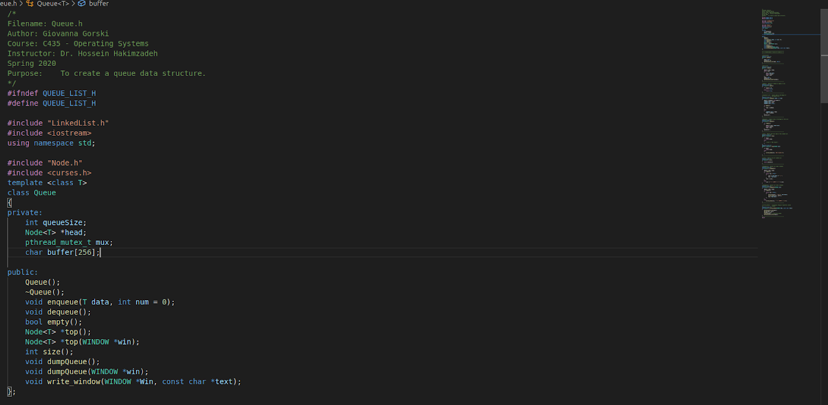

Slide 40
LinkedList

Slide 41
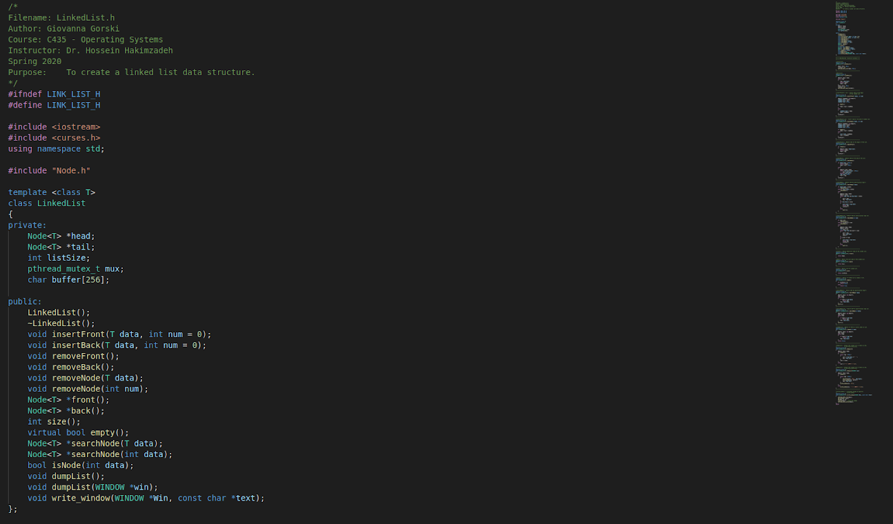

Slide 42
Window

Slide 43


Slide 44
Phase V - Ultima
The purpose of phase V is to perform some touch ups over mechanisms that were implemented along the phases that compose this project. Altogether, Ultima is divided into 4 phases in which at each phase a new Operating System mechanism is implemented. At phase one we had Semaphore and Scheduler, phase two Message Passing, phase three Memory Management, phase four and last File Systems.

Slide 45
Ultima class diagram

Slide 46
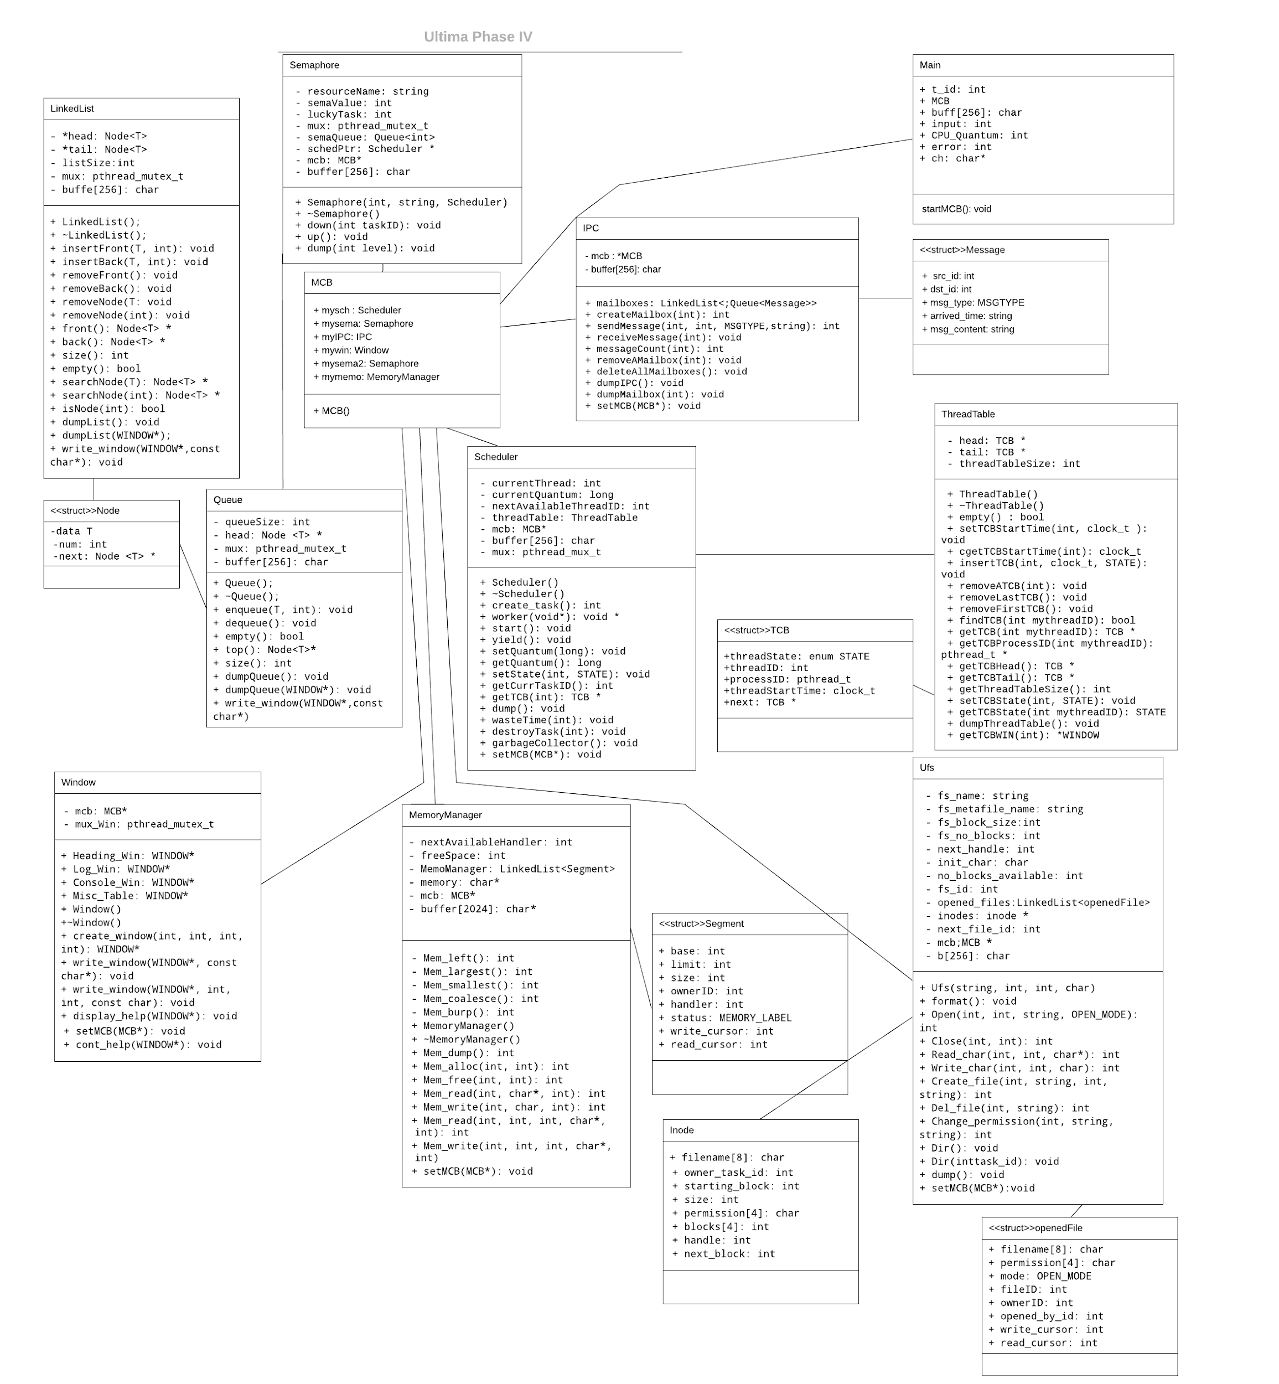

Slide 47
Organization
IPC
Semaphore
Memory Manager
Scheduler
File systems
MCB

Slide 48
Testing
Pause for demo.

Slide 49
Challenges
Phase I - Round Robin algorithm and how to make pthreads relinquish cpu.
Phase II - Master Control Block, Circular Dependency, IPC Linked List of Queues.
Phase III - Limit and Base registers, coalesce, and free.
Phase IV - How to make data persistent, loading previous information.

Slide 50
Project Timeline

Slide 51
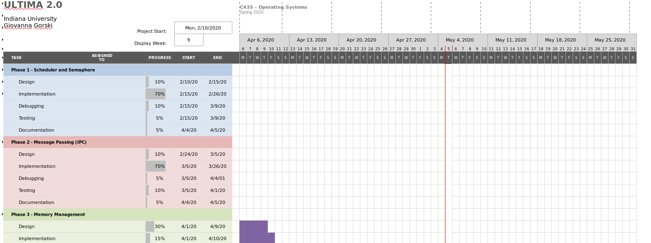

Slide 52
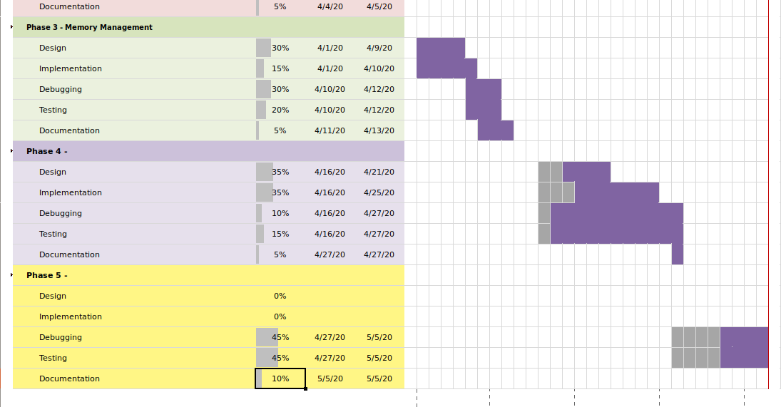

Slide 53
Conclusion
The success of each phase of this project is due mainly by labs that were assigned during the C435 Operating System class. Moreover, phase I and its successor phases would not be possible without the lab 6 and lab 5 where a framework for Ultima was provided using an array as oppose of a linked list such in this project.

